Slide 1




Transgender Issues Poll
An Ipsos Survey Conducted Exclusively for BuzzFeed
Global @dvisor – December 2016 – G@84
BuzzFeed / Ipsos Survey

Slide 2
These are the findings of an Ipsos survey conducted between October 21st and November 4th, 2016.
The survey instrument is conducted monthly in 25 countries around the world via the Ipsos Online Panel system. The 23 countries reporting herein are Argentina, Australia, Belgium, Brazil, Canada, China, France, Germany, Hungary, India, Italy, Japan, Mexico, Peru, Poland, Russia, South Africa, South Korea, Spain, Sweden, Turkey, the United Kingdom, and the United States of America.
For the results of the survey presented herein, an international sample of 17,105 adults aged 18-64 in the US and Canada, and age 16-64 in all other countries, were interviewed. Approximately 1000+ individuals participated on a country by country basis via the Ipsos Online Panel with the exception of Argentina, Belgium, Hungary, Mexico, Peru, Poland, Russia, South Africa, South Korea, Sweden and Turkey, where each have a sample approximately 500+. The precision of Ipsos online polls are calculated using a credibility interval with a poll of 1,000 accurate to +/- 3.1 percentage points and of 500 accurate to +/- 4.5 percentage points. For more information on the Ipsos use of credibility intervals, please visit the Ipsos website.
In countries where internet penetration is approximately 60% or higher the data output is comparable the general population. Of the 23 countries surveyed online, 16 yield results that are balanced to reflect the general population: Argentina, Australia, Belgium, Canada, France, Germany, Hungary, Italy, Japan, Poland, Russia, South Korea, Spain, Sweden, United Kingdom and United States. The seven remaining countries surveyed –Brazil (58% Internet penetration among the citizenry), China (50%), India (30%), Mexico (49%),Peru (53%), South Africa (49%) and Turkey (60%)—have lower levels of connectivity therefore are not reflective of the general population; however, the online sample in these countries are particularly valuable in their own right as they are more urban/educated/income than their fellow citizens and are often referred to as “Upper Deck Consumer Citizens”.
Text Color-Code Key
 | Indicates face-to- face survey
 | Indicates online, nationally representative survey
 | Indicates online survey, non-representative (“Upper Deck Consumer Citizens”)

Slide 3
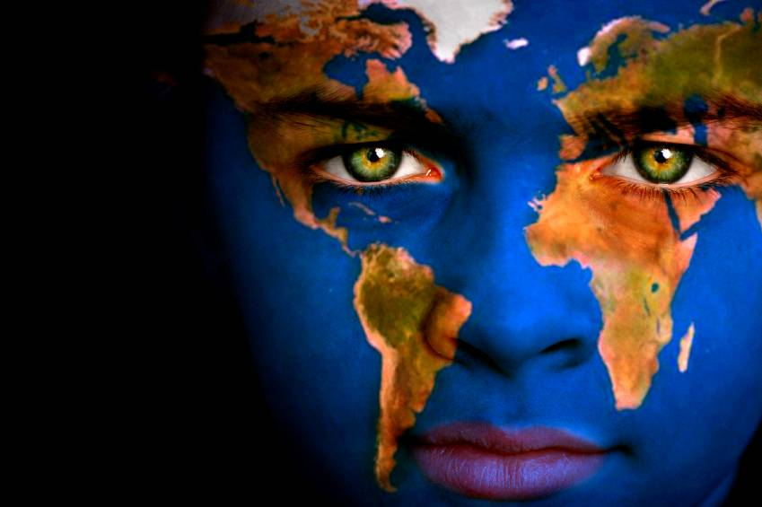
THE
WORLD at
a GLANCE

Slide 4
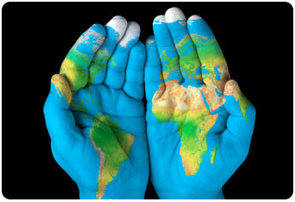
DETAILED FINDINGS

Slide 5
Some people dress and live as one sex even though they were born another. For instance, someone who was considered male at birth may feel they are actually female and so dresses and lives as a woman, and someone female at birth may feel they are actually male and dresses and lives as a man. How familiar, if at all, are you with people like this? Choose as many responses as apply.
Ipsos TrAnsgender ISsues
All countries
Turkey
India
China
South Africa
Brazil
Peru
Mexico
Base: 17,105 adults aged 16-64 across Argentina, Australia, Belgium, Brazil, Canada, China, France, Germany, United Kingdom, Hungary, India, Italy, Japan, Mexico, Poland, Russia,, South Africa, South Korea, Spain, Sweden, Turkey and the United States., Oct-Nov 2016; 610 adults aged 18-99 in India, Aug 2016

Slide 6
Some people dress and live as one sex even though they were born another. For instance, someone who was considered male at birth may feel they are actually female and so dresses and lives as a woman, and someone female at birth may feel they are actually male and dresses and lives as a man. How familiar, if at all, are you with people like this? Choose as many responses as apply.
Ipsos TrAnsgender ISsues
All countries
Brazil
Mexico
Peru
South Africa
Turkey
China
India
Base: 17,105 adults aged 16-64 across Argentina, Australia, Belgium, Brazil, Canada, China, France, Germany, United Kingdom, Hungary, India, Italy, Japan, Mexico, Poland, Russia,, South Africa, South Korea, Spain, Sweden, Turkey and the United States., Oct-Nov 2016; 610 adults aged 18-99 in India, Aug 2016

Slide 7
Some people dress and live as one sex even though they were born another. For instance, someone who was considered male at birth may feel they are actually female and so dresses and lives as a woman, and someone female at birth may feel they are actually male and dresses and lives as a man. How familiar, if at all, are you with people like this? Choose as many responses as apply.
Ipsos TrAnsgender ISsues
All countries
India
China
Turkey
South Africa
Peru
Mexico
Brazil
Base: 17,105 adults aged 16-64 across Argentina, Australia, Belgium, Brazil, Canada, China, France, Germany, United Kingdom, Hungary, India, Italy, Japan, Mexico, Poland, Russia,, South Africa, South Korea, Spain, Sweden, Turkey and the United States., Oct-Nov 2016; 610 adults aged 18-99 in India, Aug 2016

Slide 8
Thinking still about people who dress and live as one sex even though they were born another. Do you think people like this should be allowed to legally change their sex on identity documents, such as government ID cards or driving licenses? Please choose all that apply.
Ipsos TrAnsgender ISsues
All countries
Turkey
India
South Africa
Brazil
Peru
Mexico
Base: 16,100 adults aged 16-64 across Argentina, Australia, Belgium, Brazil, Canada, China, France, Germany, United Kingdom, Hungary, India, Italy, Japan, Mexico, Poland, Russia, South Africa, South Korea, Spain, Sweden, Turkey and the United States., Oct-Nov 2016; 610 adults aged 18-99 in India, Aug 2016

Slide 9
Thinking still about people who dress and live as one sex even though they were born another. Do you think people like this should be allowed to legally change their sex on identity documents, such as government ID cards or driving licenses? Please choose all that apply.
Ipsos TrAnsgender ISsues
All countries
Turkey
India
South Africa
Brazil
Peru
Mexico
Base: 16,100 adults aged 16-64 across Argentina, Australia, Belgium, Brazil, Canada, China, France, Germany, United Kingdom, Hungary, India, Italy, Japan, Mexico, Poland, Russia, South Africa, South Korea, Spain, Sweden, Turkey and the United States., Oct-Nov 2016; 610 adults aged 18-99 in India, Aug 2016

Slide 10
Global Opinion on Transgender Issues
Ipsos Transgender Issues
They should be protected from discrimination by the Government
STRONGly AGREE
SOMEWHAT AGREE
SOMEWHAT DISAGREE
Strongly Disagree
Don’t know
They should be allowed to have surgery so their body matches their identity
They should be allowed to marry a person of their birth sex
They should be allowed to conceive or give birth to children (if biologically capable of doing so)
They should be allowed to adopt children
They should be allowed to use the restroom of the sex they identify with
Base: 17,105 adults aged 16-64 across Argentina, Australia, Belgium, Brazil, Canada, China, France, Germany, United Kingdom, Hungary, India, Italy, Japan, Mexico, Poland, Russia,, South Africa, South Korea, Spain, Sweden, Turkey and the United States., Oct-Nov 2016

Slide 11
They should be protected from discrimination by the Government
Please indicate whether you agree or disagree with each statement below about people who dress and live as one sex even though they were born another
India
Peru
Mexico
South Africa
China
Brazil
Turkey

Slide 12
They should be allowed to have surgery so their body matches their identity
Please indicate whether you agree or disagree with each statement below about people who dress and live as one sex even though they were born another
All countries
Mexico
India
South Africa
Peru
Brazil
China

Slide 13
They should be allowed to marry a person of their birth sex
Please indicate whether you agree or disagree with each statement below about people who dress and live as one sex even though they were born another
All countries
Mexico
India
Brazil
South Africa
Peru
China
Turkey

Slide 14
They should be allowed to conceive or give birth to children
Please indicate whether you agree or disagree with each statement below about people who dress and live as one sex even though they were born another
India
Brazil
South Africa
Mexico
China
Turkey
Peru

Slide 15
They should be allowed to adopt children
Please indicate whether you agree or disagree with each statement below about people who dress and live as one sex even though they were born another
All countries
India
China
South Africa
Brazil
Mexico
Turkey
Peru

Slide 16
They should be allowed to use the restroom of the sex they identify with
Please indicate whether you agree or disagree with each statement below about people who dress and live as one sex even though they were born another
India
Turkey
Peru
Mexico
South Africa
Brazil
China
Russia

Slide 17
Global Opinion on Transgender Issues
Ipsos Transgender Issues
They are a natural occurrence
They have a special place in society
STRONGly AGREE
SOMEWHAT AGREE
SOMEWHAT DISAGREE
Strongly Disagree
Don’t know
They have a form of mental illness
They are violating the traditions of my culture
They have a form of physical disability
They are committing a sin
They have unique spiritual gifts
Base: 17,105 adults aged 16-64 across Argentina, Australia, Belgium, Brazil, Canada, China, France, Germany, United Kingdom, Hungary, India, Italy, Japan, Mexico, Poland, Russia, South Africa, South Korea, Spain, Sweden, Turkey and the United States., Oct-Nov 2016

Slide 18
They are a natural occurrence
Please indicate whether you agree or disagree with each statement below about people who dress and live as one sex even though they were born another
All countries
India
Turkey
China
Brazil
Mexico
South Africa
Peru

Slide 19
They have a special place in society
Please indicate whether you agree or disagree with each statement below about people who dress and live as one sex even though they were born another
All countries
India
South Africa
Peru
Turkey
Mexico
China
Brazil

Slide 20
They have a form of mental illness
Please indicate whether you agree or disagree with each statement below about people who dress and live as one sex even though they were born another
All countries
India
Turkey
China
Peru
South Africa
Mexico
Brazil

Slide 21
They are violating the traditions of my culture
Please indicate whether you agree or disagree with each statement below about people who dress and live as one sex even though they were born another
All countries
India
Turkey
China
South Africa
Brazil
Peru
Mexico

Slide 22
They have a form of physical disability
Please indicate whether you agree or disagree with each statement below about people who dress and live as one sex even though they were born another
All countries
India
China
Turkey
South Africa
Peru
Brazil
Mexico

Slide 23
They are committing a sin
Please indicate whether you agree or disagree with each statement below about people who dress and live as one sex even though they were born another
All countries
India
Turkey
Brazil
South Africa
Peru
Mexico
China

Slide 24
They have unique spiritual gifts
Please indicate whether you agree or disagree with each statement below about people who dress and live as one sex even though they were born another
All countries
Turkey
India
China
South Africa
Peru
Mexico
Brazil

Slide 25
Could you please identify any that you would not like to have as (choose as many or few as you prefer for each row)-I would not like to have neighbors who are…
Ipsos TrAnsgender ISsues
All countries
Turkey
India
China
South Africa
Brazil
Peru
Mexico
Base: 16,100 adults aged 16-64 across Argentina, Australia, Belgium, Brazil, Canada, China, France, Germany, United Kingdom, Hungary, India, Italy, Japan, Mexico, Poland, Russia, South Africa, South Korea, Spain, Sweden, Turkey and the United States., Oct-Nov 2016; 610 adults aged 18-99 in India, Aug 2016

Slide 26
As you may know or have heard, the Supreme Court in India issued a ruling in 2014 ordering the government to implement protections for people who dress and live as one sex even though they were born another, in order to correct past discrimination. Do you personally agree or disagree with this court ruling?
Ipsos TrAnsgender Issues: india
Base: 610 adults aged 18-99 in India, Aug 2016

Slide 27
Please indicate whether you agree or disagree with each statement below about people who dress and live as one sex even though they were born another. ‘Strongly/Somewhat agree’
Ipsos TrAnsgender Issues: India
Base: 610 adults aged 18-99 in India, Aug 2016

Slide 28
In 2015, the Rajya Sabha unanimously voted in favor of legislation that would protect people who dress and live as one sex even though they were born another from discrimination, but it was never passed by the Lok Sabha and has not become law. Would you support or oppose government enacting such legislation?
Ipsos TrAnsgender Issues: India
Base: 610 adults aged 18-99 in India, Aug 2016

Slide 29
About Ipsos
Ipsos is an independent market research company controlled and managed by research professionals. Founded in France in 1975, Ipsos has grown into a worldwide research group with a strong presence in all key markets. Ipsos ranks third in the global research industry.
With offices in 87 countries, Ipsos delivers insightful expertise across five research specializations: brand, advertising and media, customer loyalty, marketing, public affairs research, and survey management.
Ipsos researchers assess market potential and interpret market trends. They develop and build brands. They help clients build long-term relationships with their customers. They test advertising and study audience responses to various media and they measure public opinion around the globe.
Ipsos has been listed on the Paris Stock Exchange since 1999 and generated global revenues €1,669.5 ($2,218.4 million) in 2014.
Visit www.ipsos.com to learn more about Ipsos’ offerings and capabilities.

Slide 30
For information about this and other Global @dvisor products contact http://www.ipsosglobaladvisor.com/ or:
Julia Clark Senior Vice President Ipsos Public Affairs +1 (312) 526-4919 julia.clark@ipsos.com
Chris Jackson Vice President Ipsos Public Affairs +1 (202) 420-2025 Julia.clark@ipsos.com
The Ipsos Global @dvisor Syndicate Study is a monthly, online survey of consumer citizens in 24 countries and produces syndicated reports and studies specifically tailored to the needs of corporations, advertising and PR agencies, and governments. For information contact:
Chris Deeney Senior Vice President and Managing Director Ipsos Public Affairs +1 (312) 665-0551 chris.deeny@ipsos.com
Visit www.ipsos.com for information about all of our products and services. Copyright Ipsos 2010. All rights reserved. The contents of this publication constitute the sole and exclusive property of Ipsos.

